Slide 1
PHONEBOOK APPLICATION
- BY LISHA BOHRA(1DS21MC049)

Slide 2
INTRODUCTION:
The PhoneBook application is a web-based contact management system that allows users to store and manage their contacts efficiently. It provides a convenient way to store, retrieve, and delete contact information, such as names, phone numbers, and email addresses.

Slide 3
TECHNOLOGY USED:
Node.js
Express.js
MongoDB Atlas
Postman API
HTML/CSS / Javascript
EJS (Embedded JavaScript)
Git

Slide 4
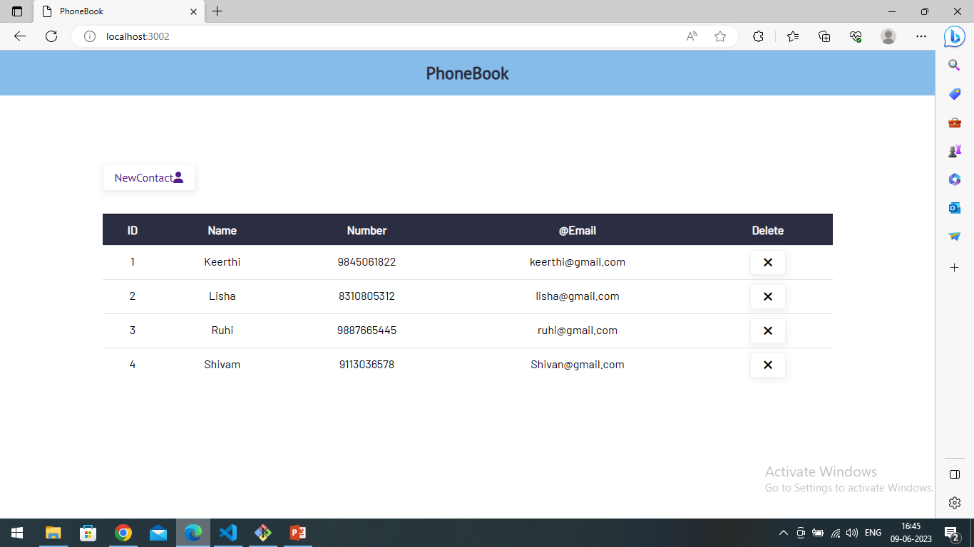

Slide 5
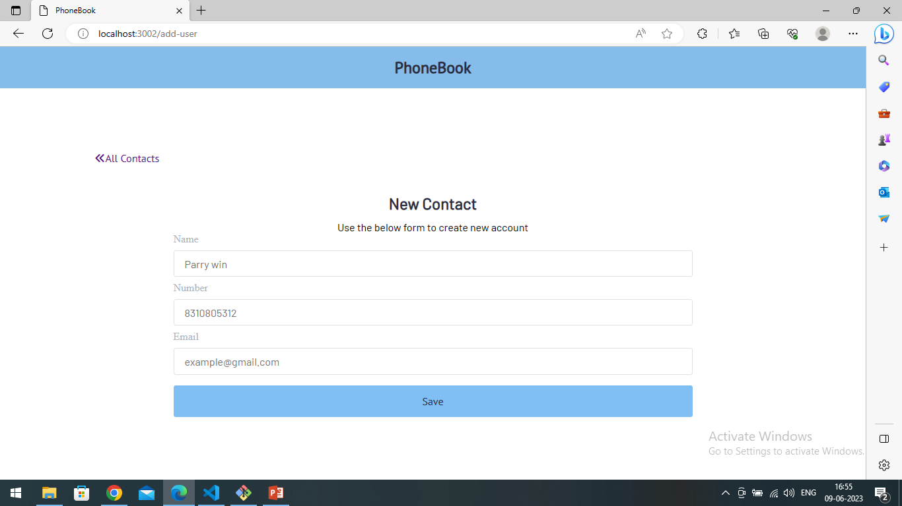

Slide 6
Conclusion:
The PhoneBook application simplifies the task of contact management by offering a user-friendly interface and robust functionality. It enables users to organize and access their contact information conveniently. The PhoneBook application proves to be an essential tool for individuals and organizations to effectively manage their contacts.

Slide 7
Github Link:
Phonebook_Nodejs
https://github.com/lishabohra/PhoneBook_NodeJs.git

